Slide 1
VBO365 Lab Guide

Slide 2
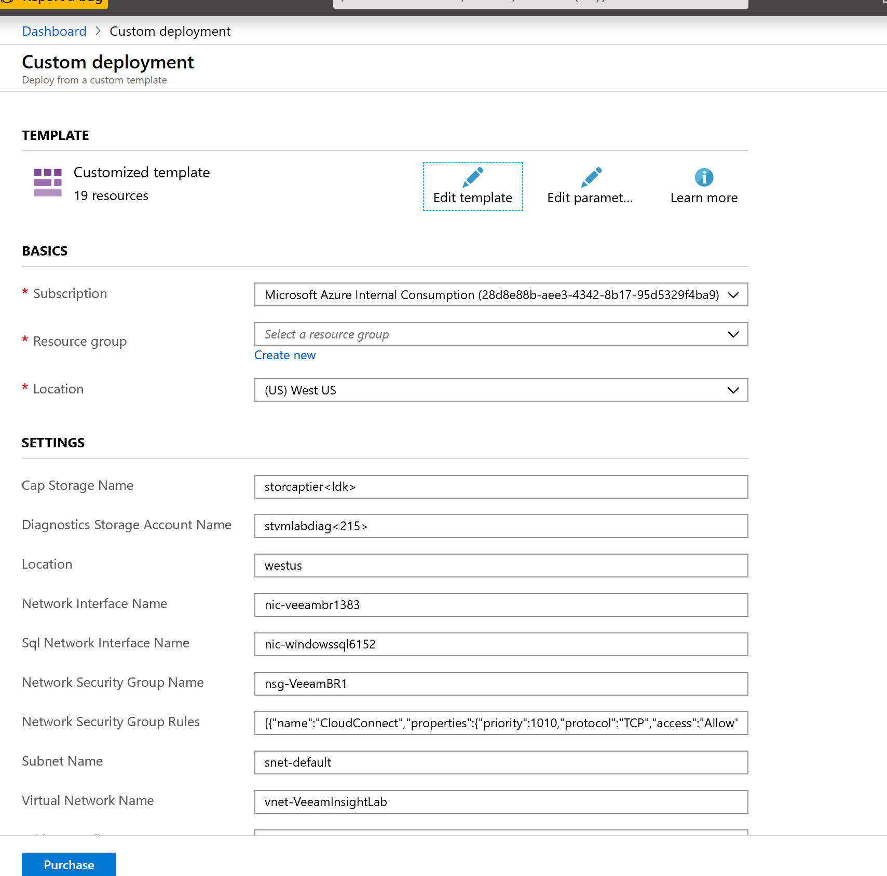
Lab Infrastructure Setup
Open the VBOAzure lab Github repo
Review the README.md instructions
Download the Lab guide pptx
Sign into portal.azure.com
Click “Deploy To Azure” button from the Github repo page
Provide a globally unique name for your storage accounts*
Cap Storage name
Diagnostics Storage Account Name
*Azure storage accounts must have a globally unique name between 3 and 24 characters (all lowercase, no special chars)

Slide 3
During deployment
Register for VBO Trial (https://www.veeam.com/vm-backup-recovery-replication-software.html)
Or use provided Not-for-resale key (provided by Veeam)
Validate Azure deployment succeeded and record following for later:
Name of your Azure backup target storage account
Access key for the backup storage account
Go to the newly created storage account and click access keys and choose either key1 or key2
Internal IP for each of the servers deployed (VeeamBR, LinuxVM1, SQLVM1)

Slide 4
Azure Lab Environment
Virtual Network
vnet-VBO1
Subnet (192.168.2.0/24)
Storage service endpoint
Virtual Machines (1)
vm-VBO1 – Veeam Backup for O365 server
One attached data disk
NICs attached to above VM
Public IP for vm-VBO1
Use this for RDP
Azure Blob Storage Accounts
Backup storage – Azure blob storage target for O365 backups
Diagnostic storage – Used by VMs for boot diagnostic logs

Slide 5
Veeam Components Review
VBO Server
Backup & Replication Console
Repositories
Direct Attach / “On-premises” / storage appliance
Object Storage - Azure
Scale Out Repo = “On-Prem” + Object Storage tiering
Other concepts
Proxies
etc

Slide 6
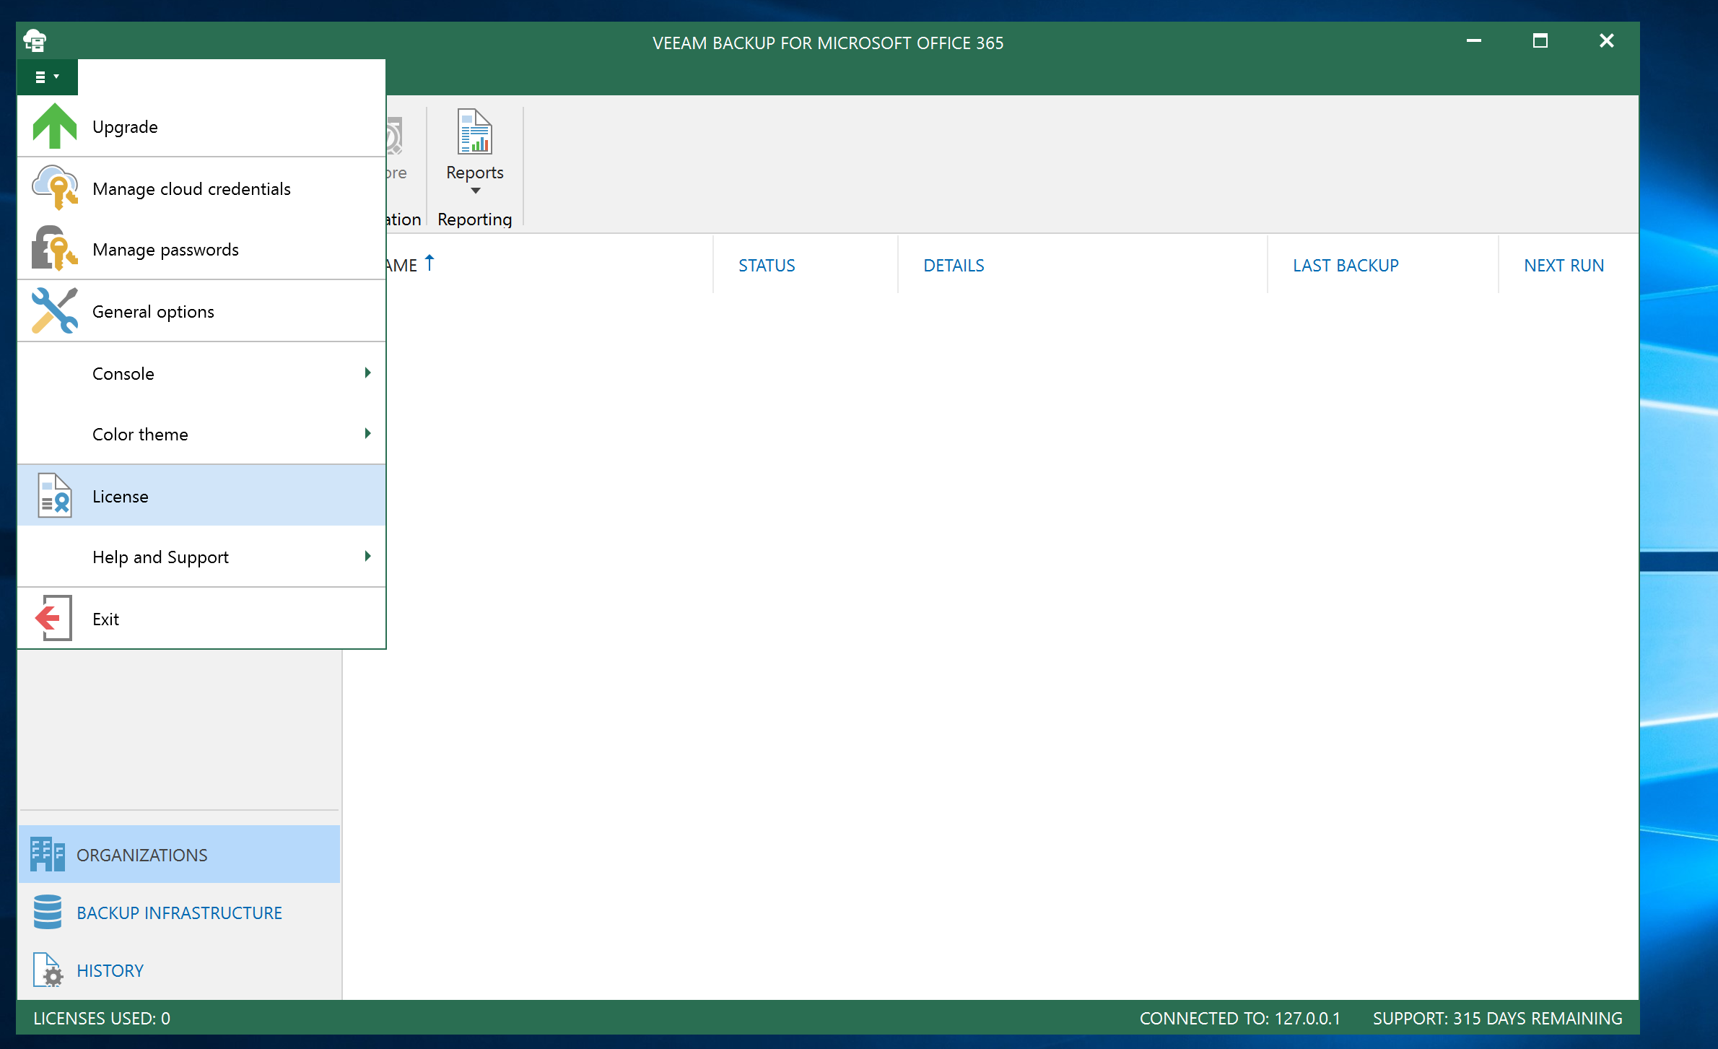
Veeam License and Registration
RDP into vm-VBO1 (get connection info from azure portal)
Browse to Veeam.com and download trial license key you registered for earlier
Start VBO Console from desktop shortcut and install license

Slide 7
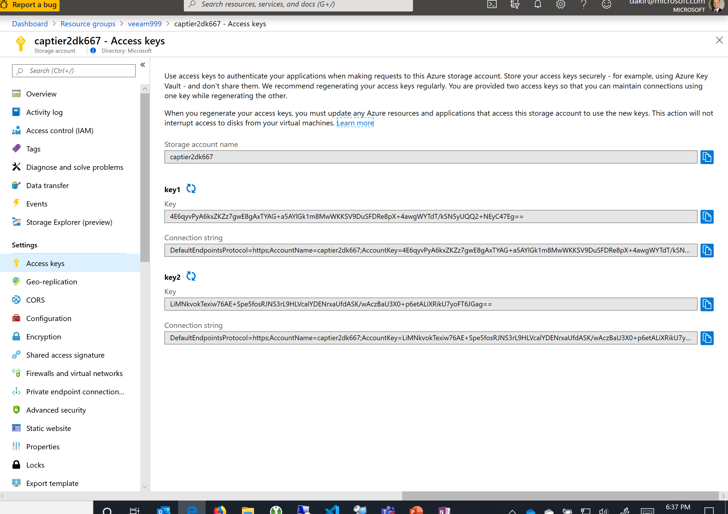
Configure Azure Storage Credentials
Select Manage Cloud Credentials from top left menu of VBO Console
Add->Azure Storage
Provide the name of your Azure backup storage account
Provide one of the access keys (get it from the “Access Keys” blade on the storage account resource in Azure Portal)

Slide 8
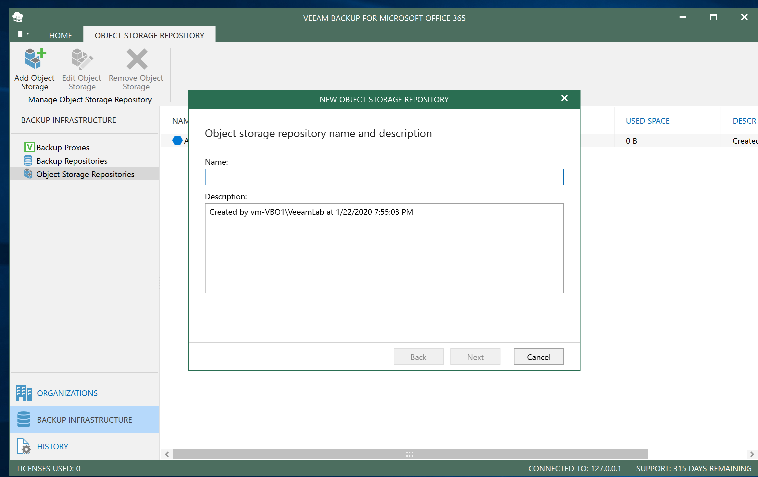
Configure Object Storage Repo
Add object storage repo on the Backup Infrastructure tab of VBO
Use the cloud credentials you just added and select your storage account
On the Container section of the wizard, browse your storage account and create a new folder called “Backups”
Click “Finish”

Slide 9
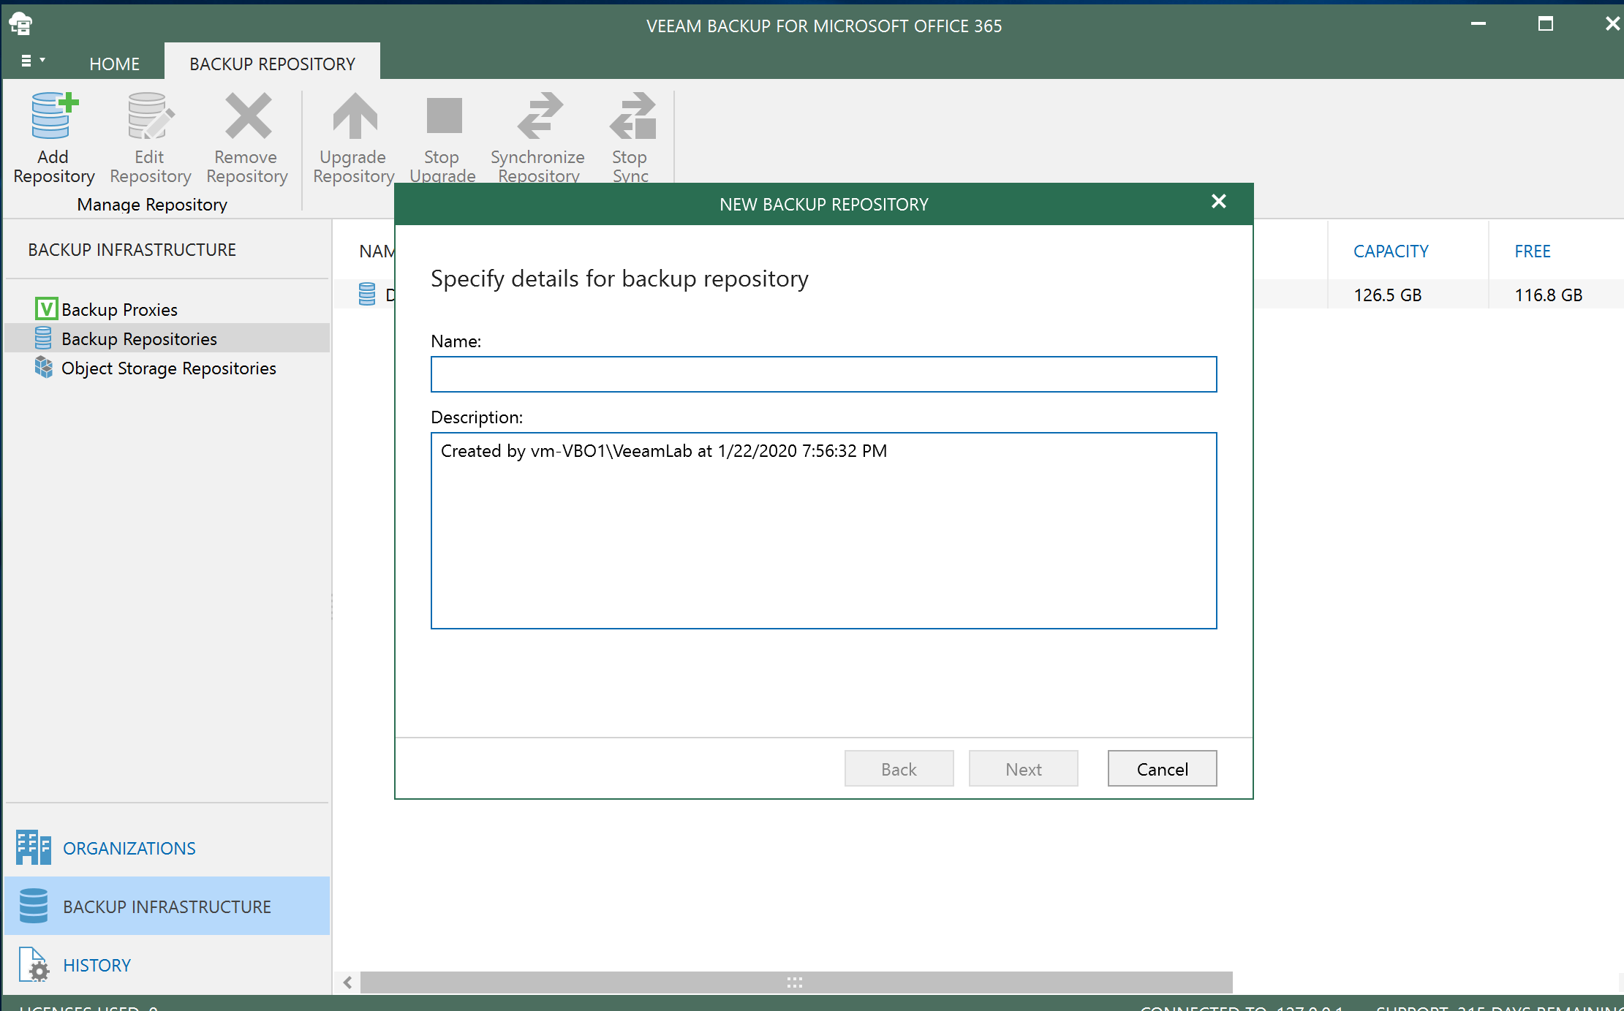
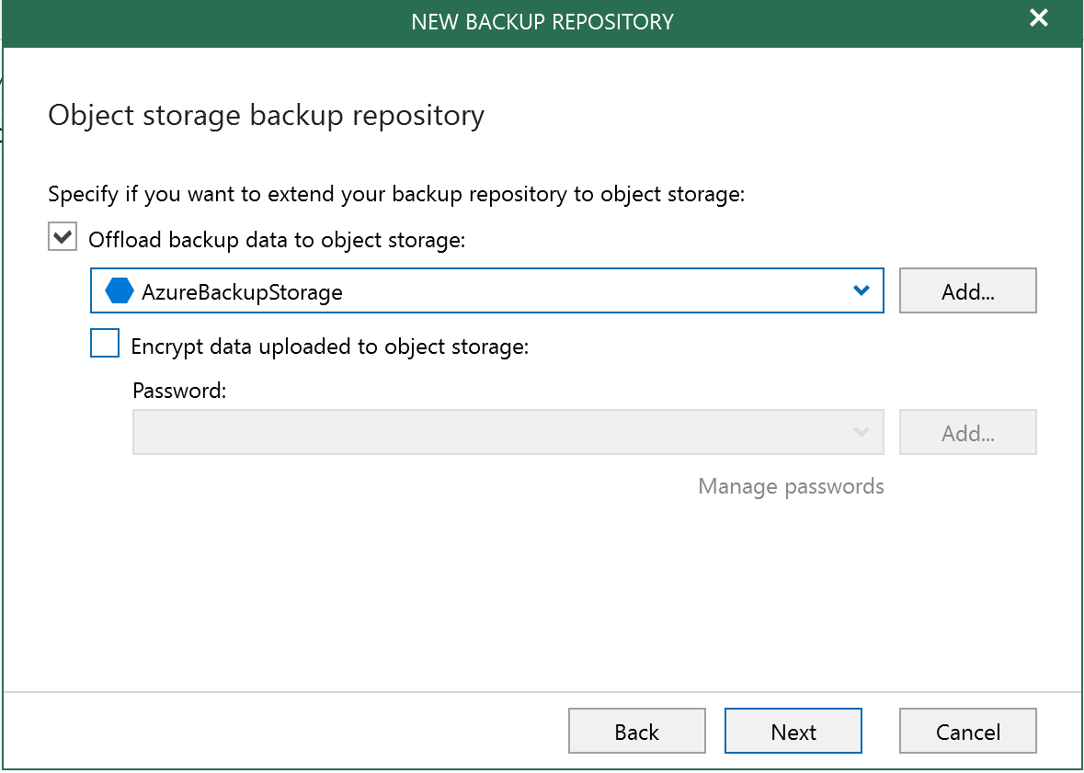
Configure VBO Backup storage repository
Add primary backup repo (“on prem”)
Select F drive as backup repo local path
On “object storage backup repository” step, choose “Offload backup data to object storage” and select in the dropdown the Azure Backup repo you created in the previous task
Use defaults for all other options

Slide 10
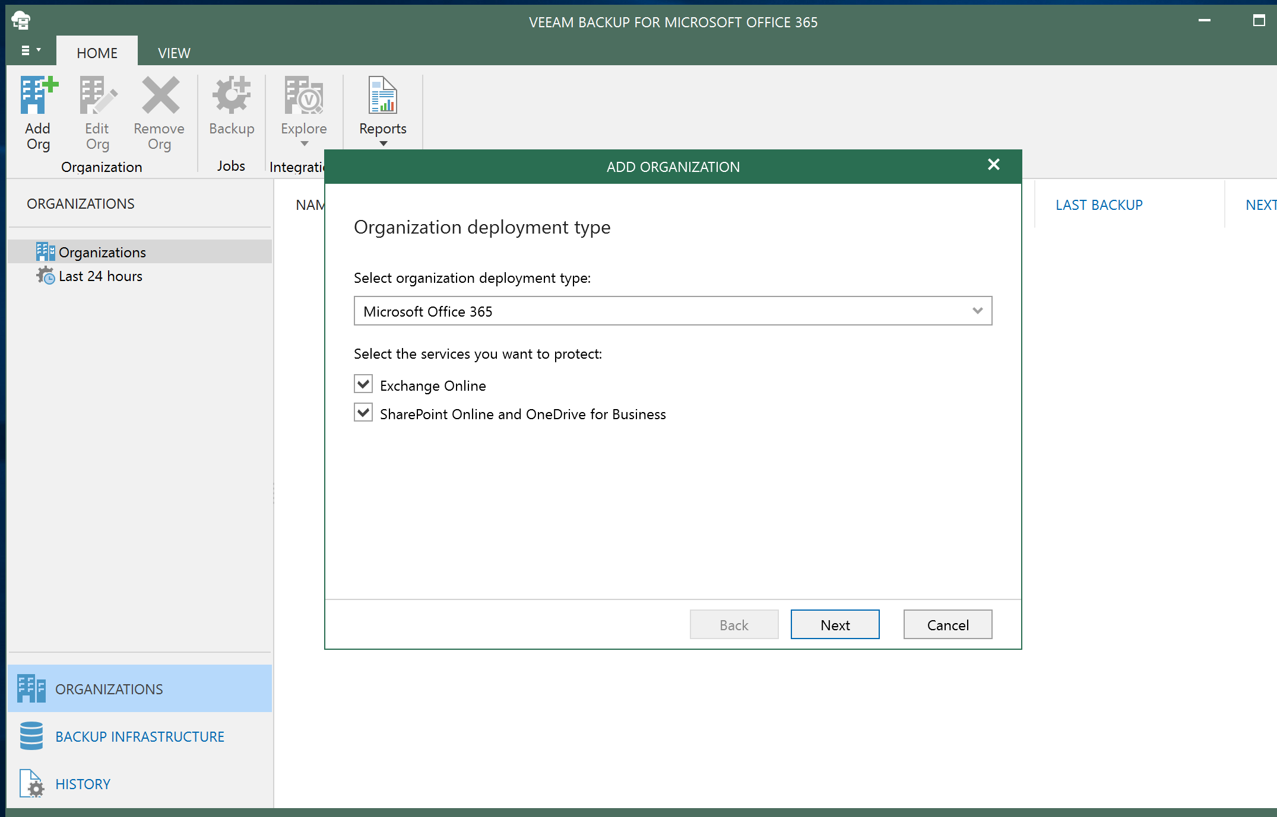
Add source O365 organization
Open the Organizations tab of VBO
Select the Add Org button and follow the wizard to add the O365 tenant you want to protect with Veeam backups to Azure.
Note: if you need a demo O365 tenant to use with a customer, you can create a “Quick Tenant” at https://cdx.transform.microsoft.com/ by logging in with an enabled partner account

Slide 11
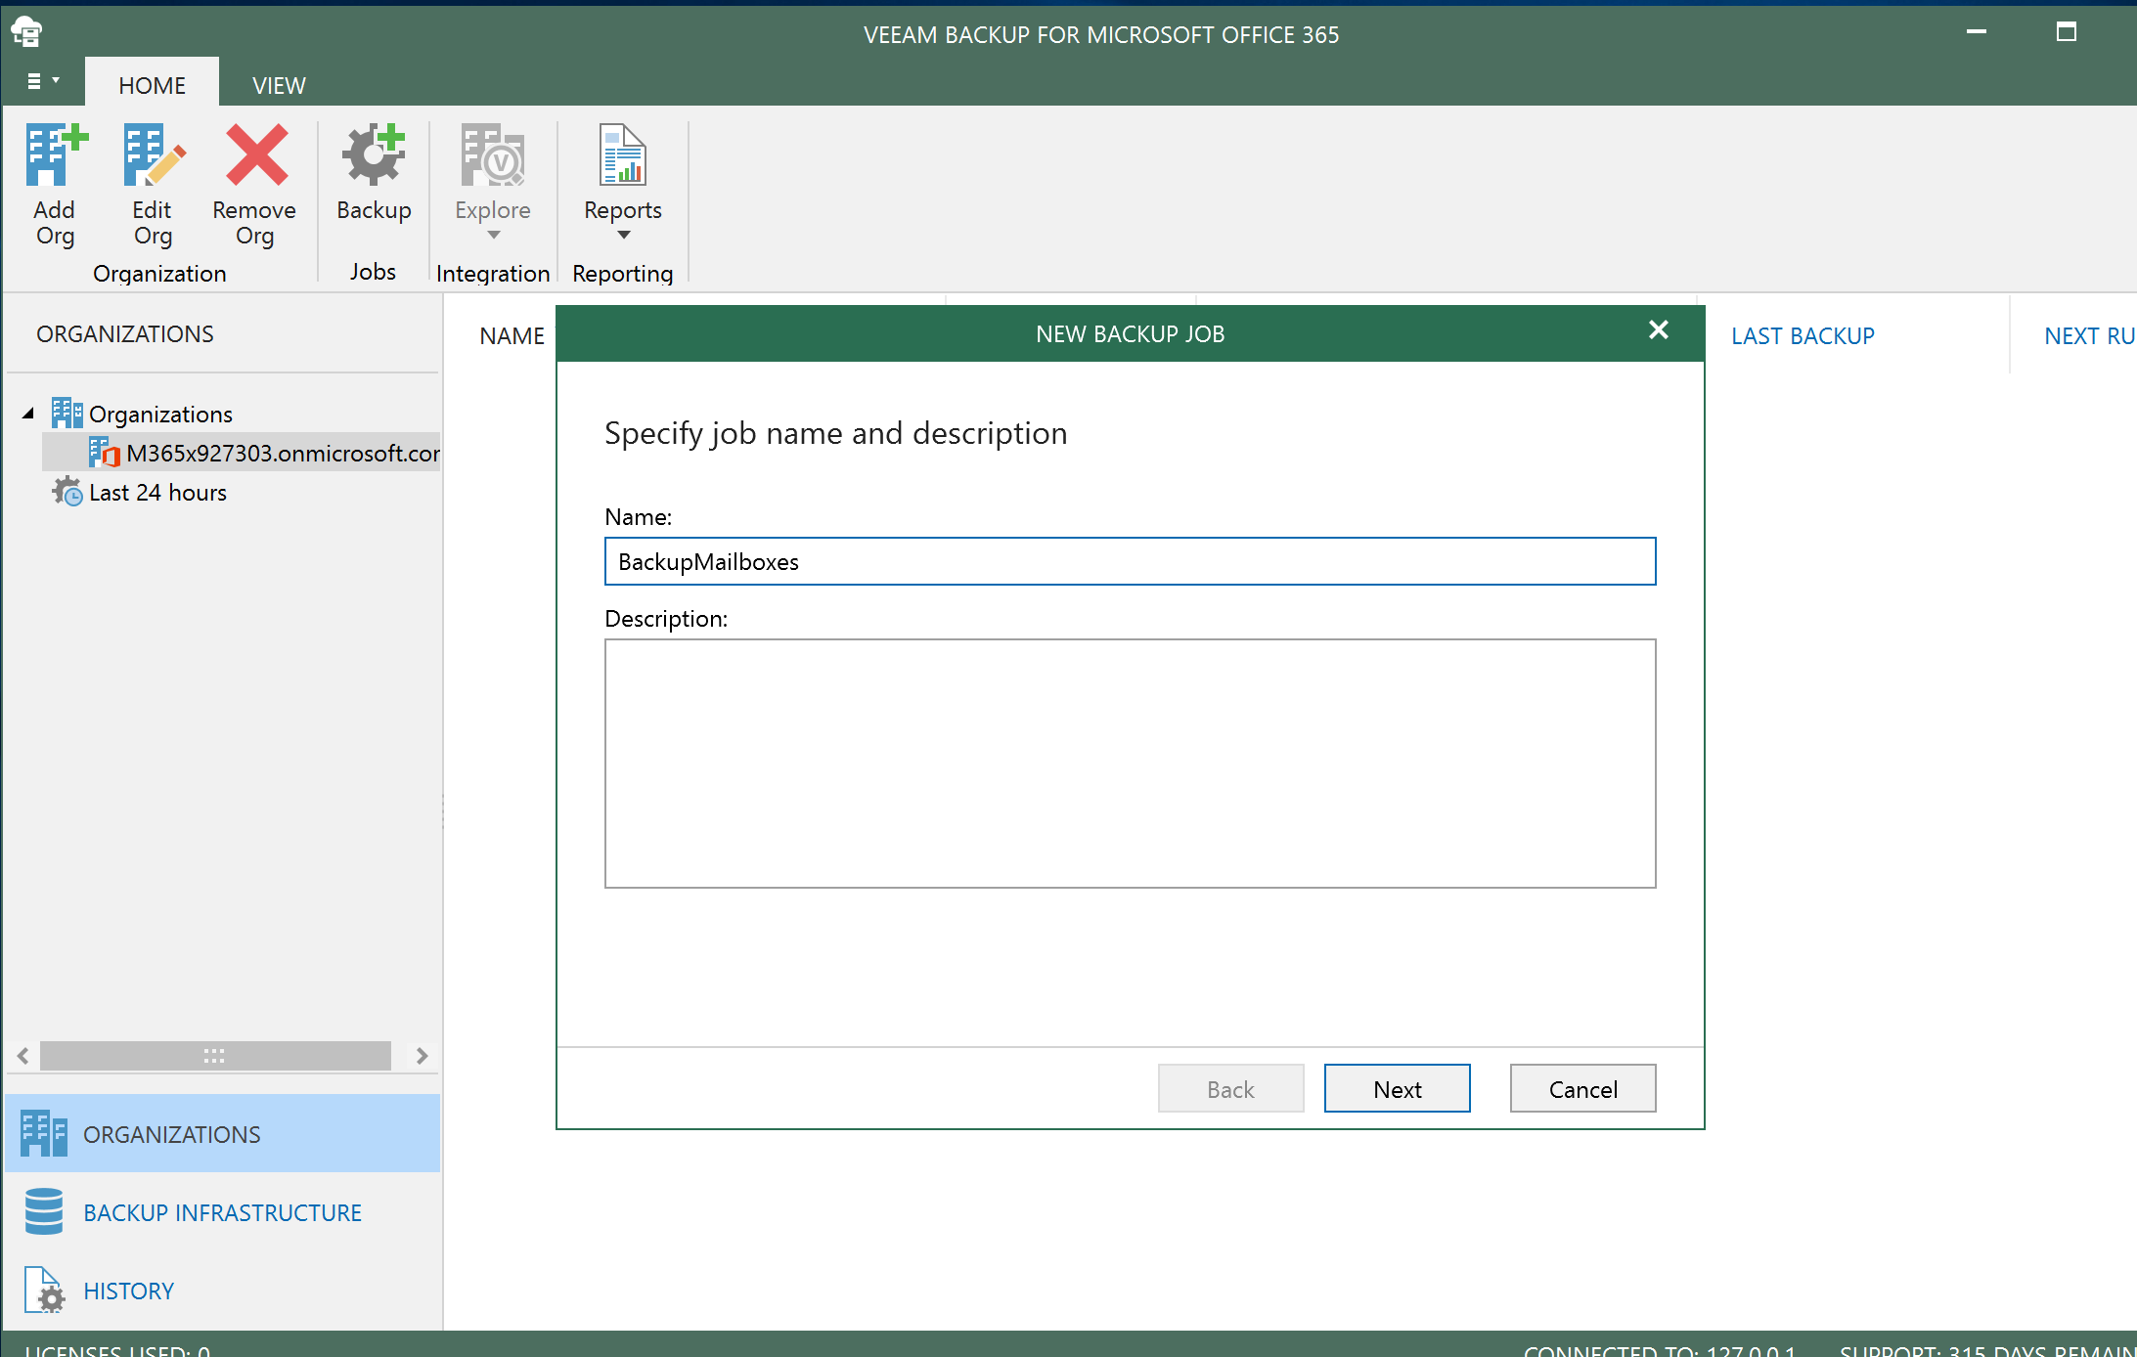
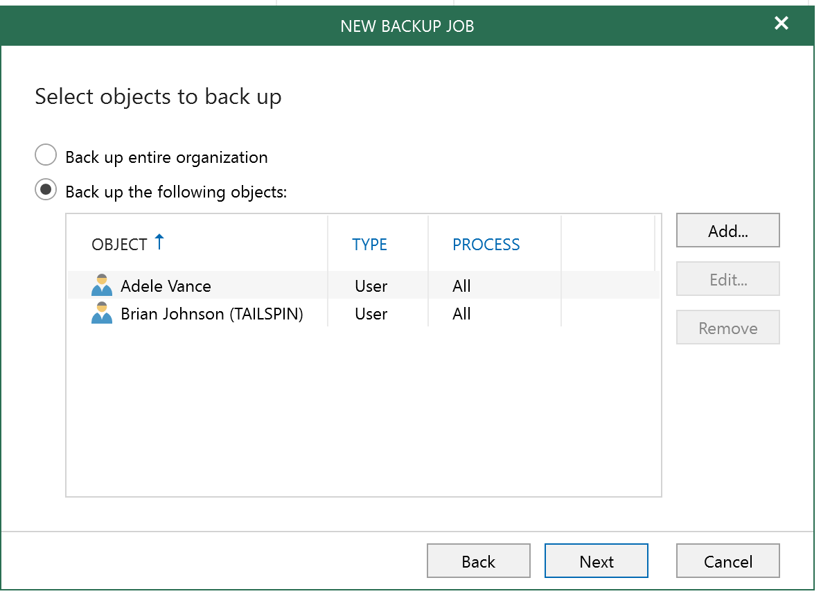
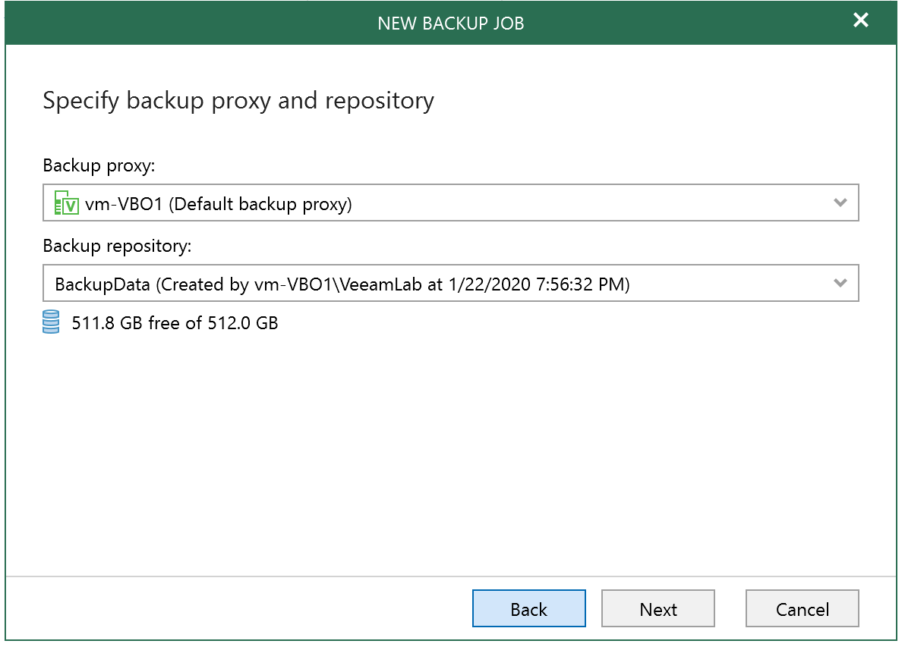
Create a Backup Job
1
Select the O365 organization you just added and click the Backup button from the ribbon
Follow the prompts to create the backup job.
Recommended: select a subset of the O365 tenant objects for demo purposes (for POC feel free to backup the entire org)
E.g., select a couple of user mailboxes for demonstrating to a live audience. If delivering a POC, then backup the entire org instead.
Step 3 - Important: On the “Specify backup proxy and repository” step, make sure you select the backup repository you created earlier that includes the Azure Object storage repo.
2
3

Slide 12
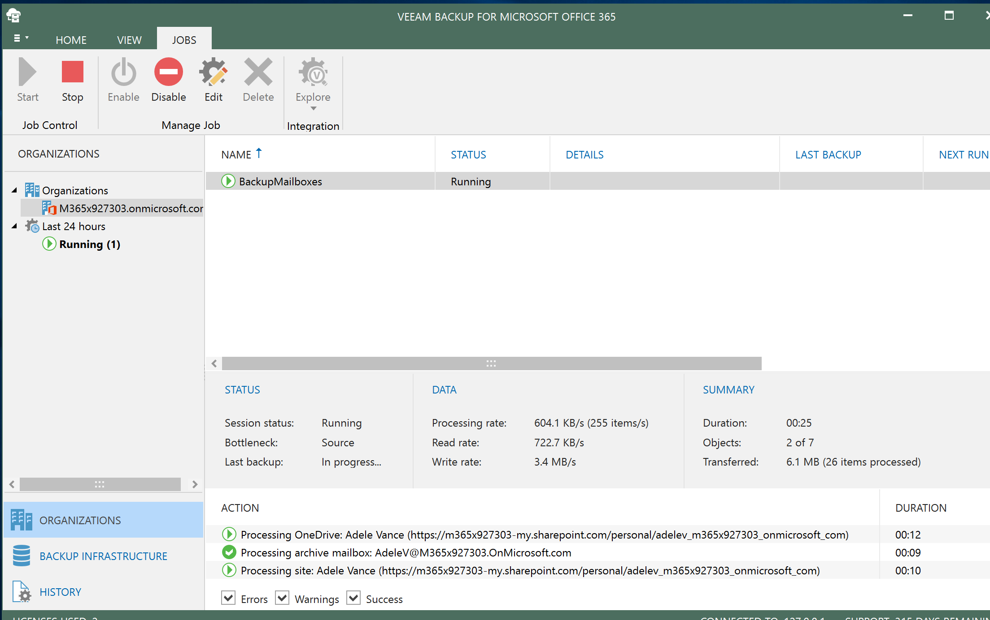
Start and Monitor backup job
Select the backup job you created and start it.
You can use this view to monitor the job progress, check errors on failed jobs, get statistics, etc.

Slide 13
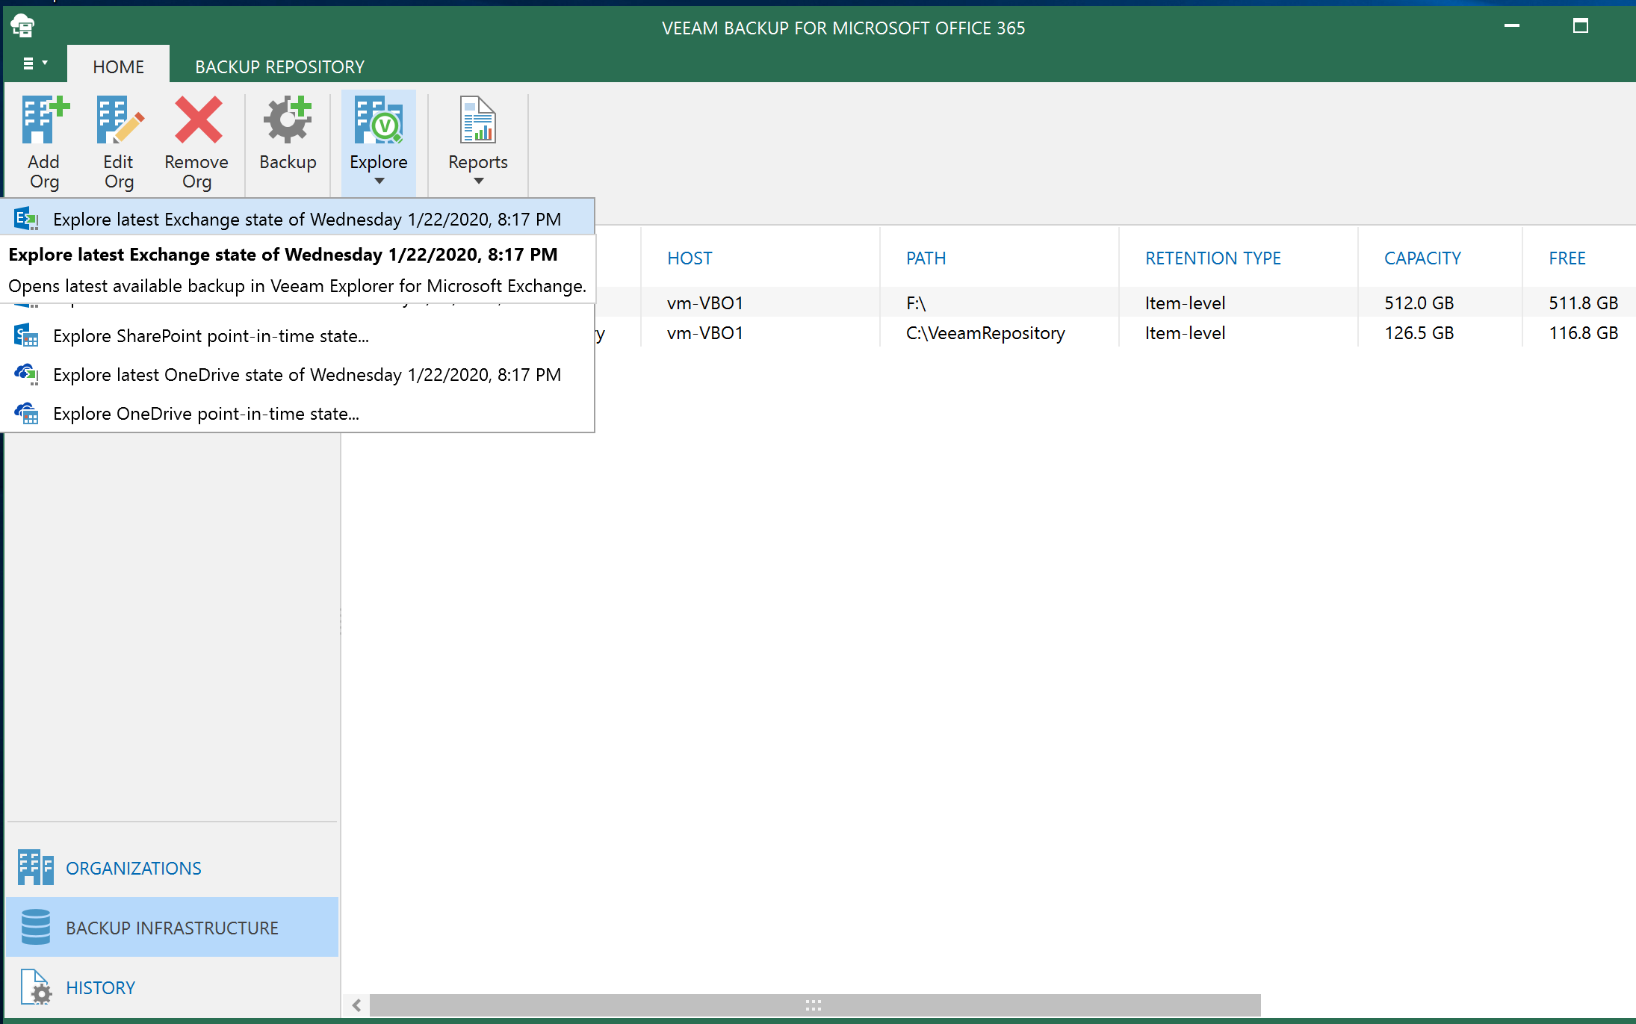
Use Veeam Explorer to look at backed up data and perform restores
From Home tab, click Explore -> Explore latest Exchange state

Slide 14
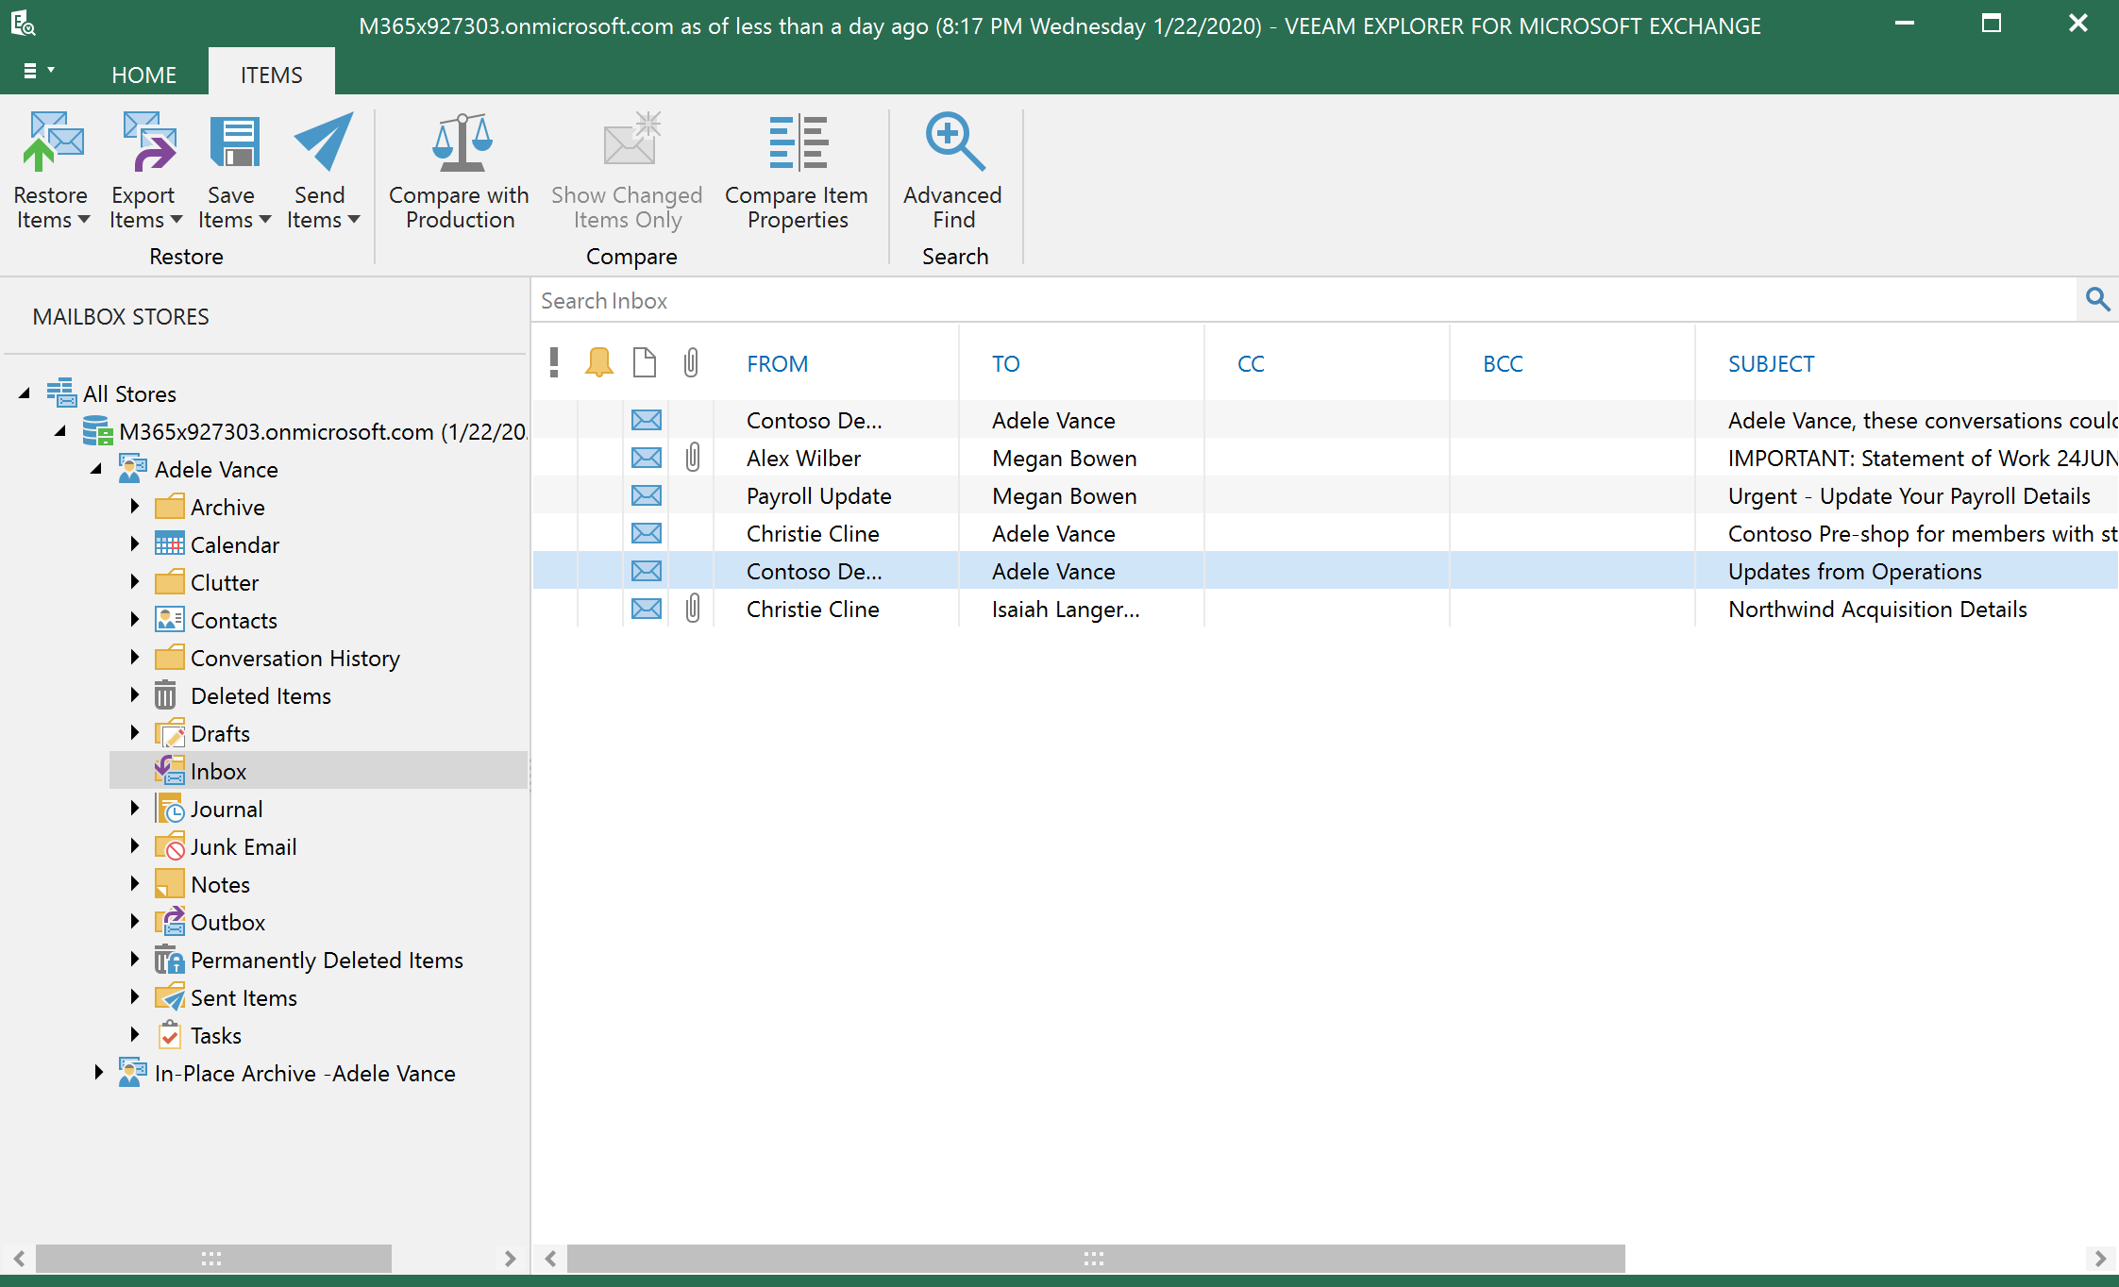
Browse backed up mailbox directly from Veeam and review restore operations

Slide 15
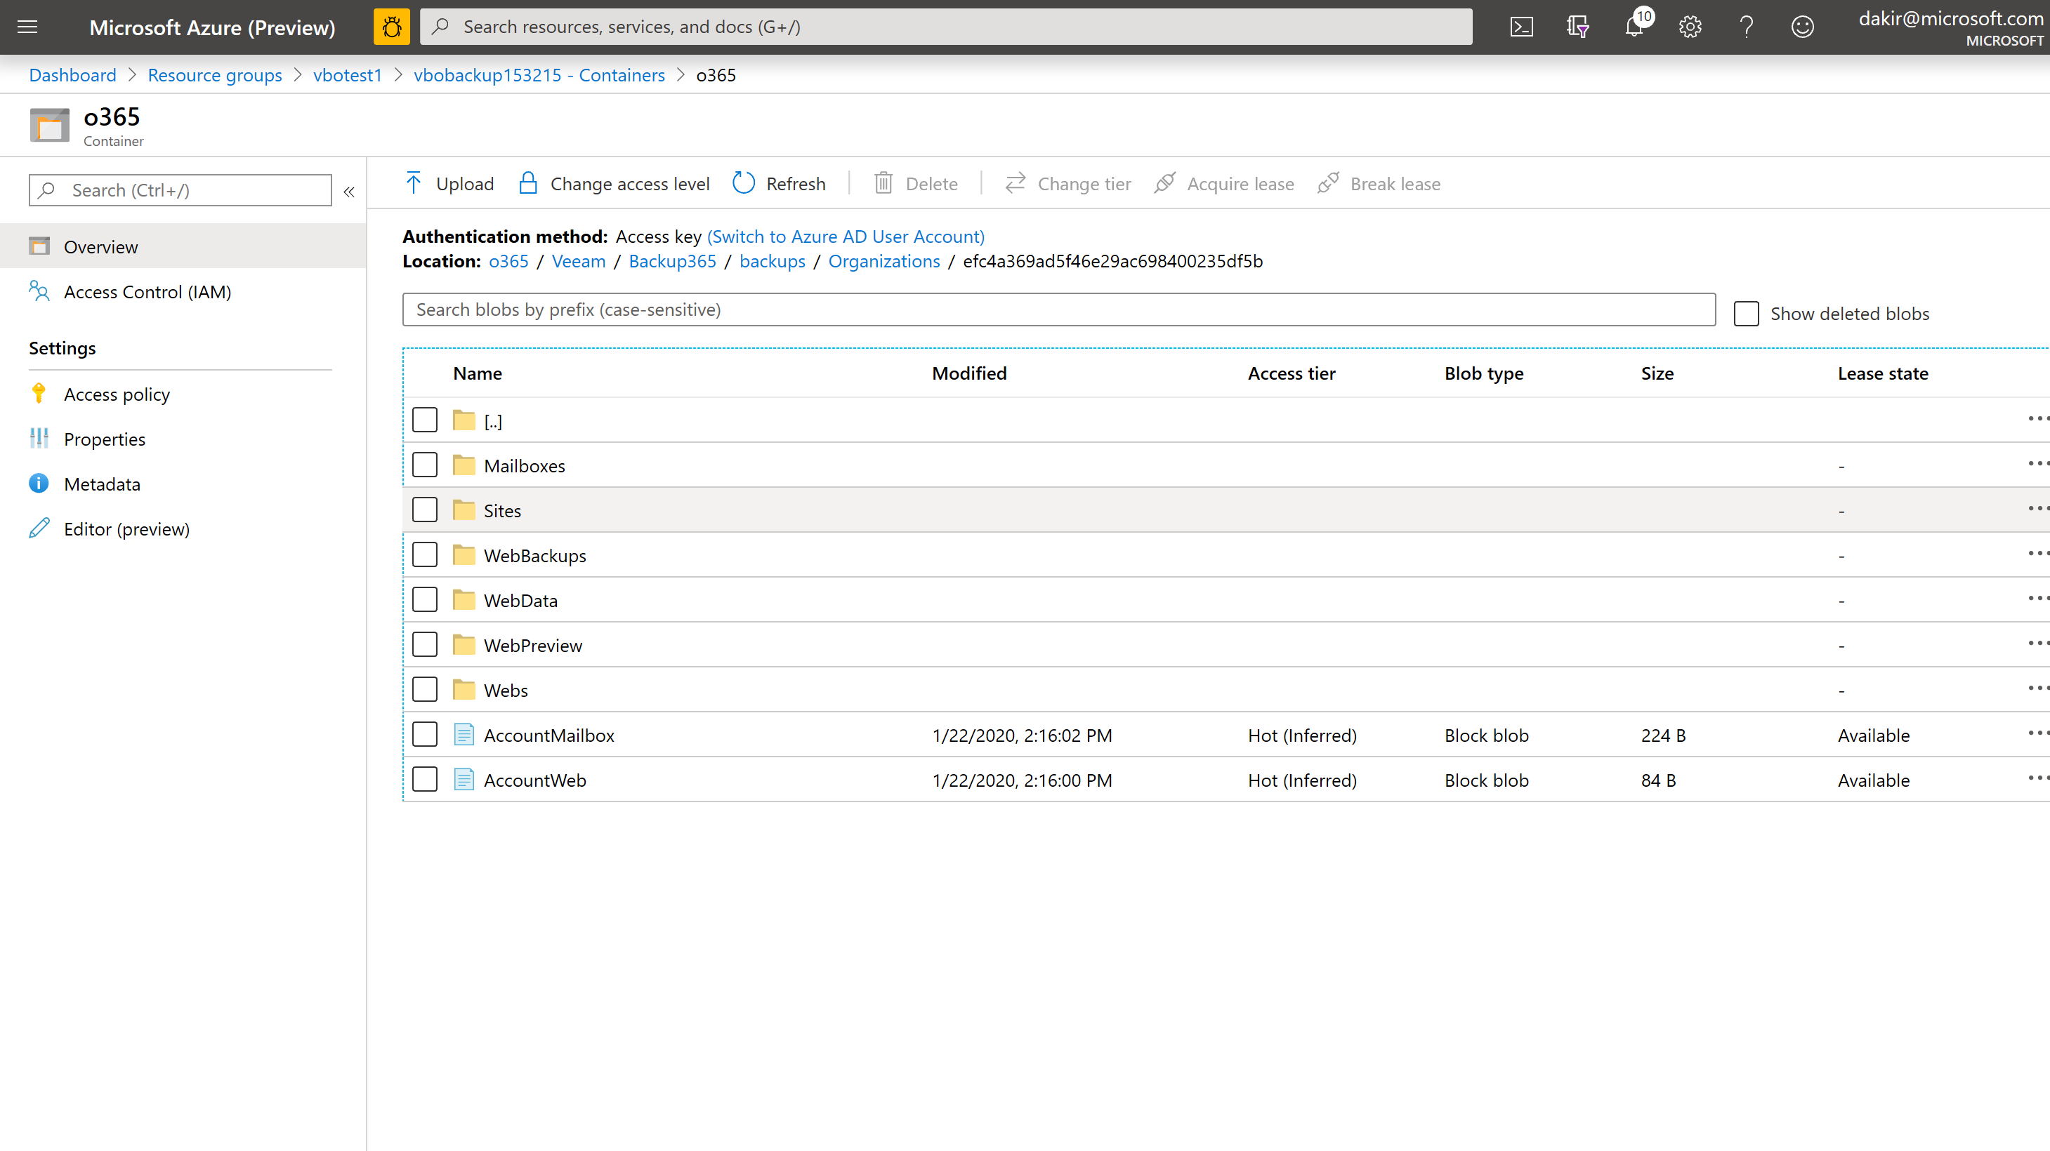
Open Azure portal and backup storage account resource to demo backup data being immediately pushed to Azure storage

Slide 16
Clean up lab resources
Delete the resource group created in the lab setup
Verify all resources removed

